Slide 1
secure data hiding in images using steganography
CAPSTONE PROJECT
Presented By:
Student Name : Adithyan S
College Name & Department : Vellore Institute of Technology & Btech integrated software engineering

Slide 2
OUTLINE
Problem Statement
Technology used
Wow factor
End users
Result
Conclusion
Git-hub Link
Future scope

Slide 3
Problem Statement
Existing communication methods often expose messages to security risks, including interception, unauthorized access, and cyber threats. While encryption protects data, encrypted messages are easily noticeable, potentially leading to further scrutiny or decryption attempts.
This project aims to develop a secure image steganography system that allows users to hide and extract secret messages within images using the Least Significant Bit (LSB) method. The system should provide a user-friendly graphical interface to encode and decode messages efficiently without compromising image quality.

Slide 4
Technology used
Libraries Used:
Pillow (PIL) – For handling and modifying images (pip install pillow).
CustomTkinter – For creating a modern, user-friendly GUI (pip install customtkinter).
Tkinter – Standard Python library for building graphical interfaces.
Platforms & Requirements:
Programming Language: Python (3.x)
Supported OS: Windows, macOS, Linux
Image Format Supported: PNG
IDE (Recommended): PyCharm, VS Code, Jupyter Notebook
Installation Method: Libraries can be installed using pip install pillow customtkinter.

Slide 5
Wow factors
Cross-Platform Support | ✅ Windows, macOS, Linux | ⚠️ Windows Only in some cases
Error Handling & User Alerts | ✅ Yes | ❌ No (Basic print messages)
Modern UI (Dark Mode) | ✅ Yes (CustomTkinter) | ❌ No (Basic Tkinter)
Feature | This Project | Other Steganography Projects
Delimiter for Accurate Extraction | ✅ Yes (#### Marker) | ❌ No (May retrieve corrupted messages)
Minimal Image Distortion | ✅ LSB Optimization | ⚠️ May cause noticeable artifacts
High-Speed Processing | ✅ Optimized | ⚠️ Slower in some cases

Slide 6
End users
This project is useful for cybersecurity, digital forensics, journalism, corporate security, and personal privacy protection. It is designed for anyone who values secure, hidden communication without raising suspicion.

Slide 7
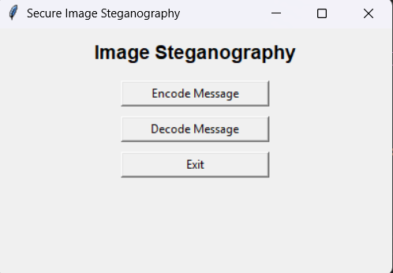
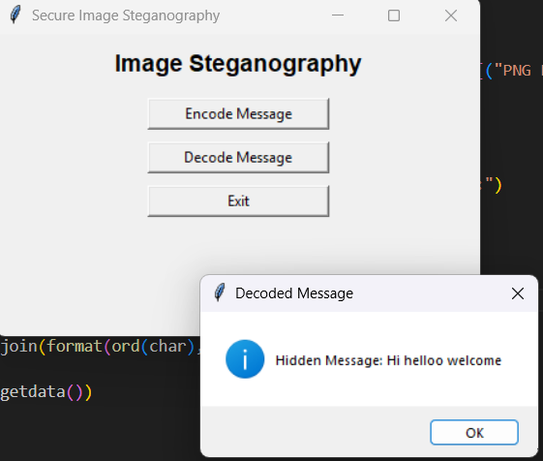
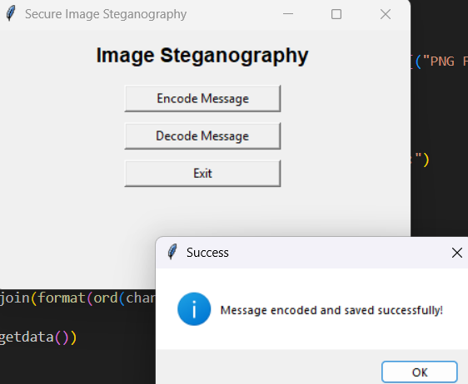
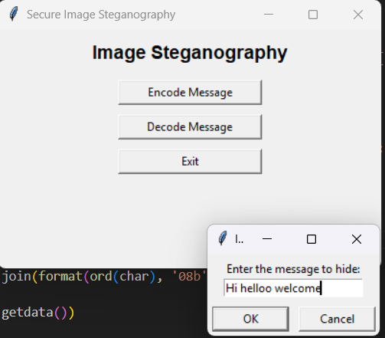
Results

Slide 8
Conclusion
This project provides a safe and hidden way to communicate sensitive information using image steganography. Unlike traditional encryption, which can attract attention, this method hides messages inside images without altering their appearance.
Using the Least Significant Bit (LSB) technique, the system ensures high accuracy and minimal image distortion. The modern, user-friendly interface makes it easy for anyone—from cybersecurity experts and journalists to privacy-conscious users—to encode and decode messages securely.
With fast processing, error-free extraction, and cross-platform support, this project offers a practical and efficient solution for covert communication and digital security.

Slide 9
GitHub Link
https://github.com/Adithyan1919/secure-data-hiding-in-images-using-steganography.git

Slide 10
THANK YOU

